Slide 1
Introduction
Object Orientated Programming in Java
Benjamin Kenwright

Slide 2
Outline
What do we mean by Object Orientated Programming?
Why Java?
Structure of the Course
Assessment/Marking
Today’s Practical
Review/Discussion

Slide 3
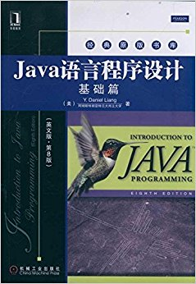
Recommended Reading
Introduction to Java Programming by Daniel Liang (Pearson Publishing)
  Ebook Available
  https://zjnu2017.github.io/OOP

Slide 4
Assessment
1. Attendance and Participation:10%
2. Experiments： 40%;
3. Examination： 50%.

Slide 5
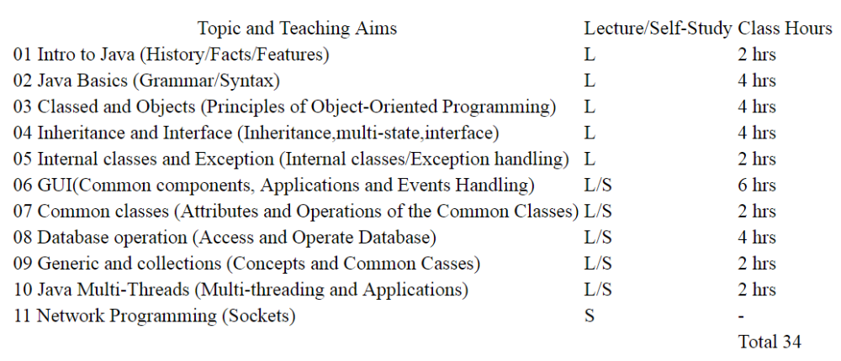

Lessons

Slide 6
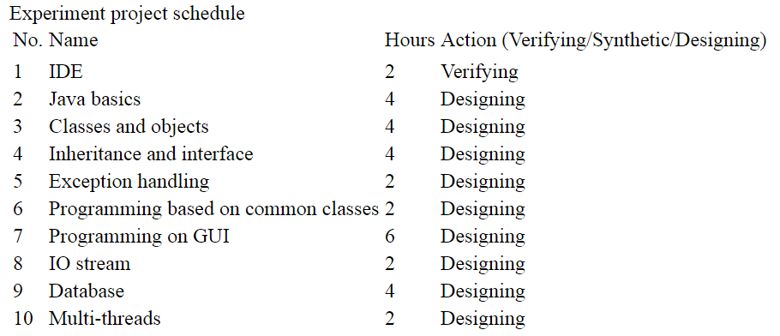
Practicals

Slide 7
Hands-On
Hands-On Course
Exciting & Challenging
Practice/Work through Examples
Experiment/Trial-and-Error
Don’t be afraid to make mistakes
Learn by `DOING’ (not just theory)

Slide 8
Contact
Questions/Issues
  Benjamin Kenwright
  email: bkenwright@ieee.org
Open Door Policy
  Problems/Help
  Within Reason

Slide 9
Today
Getting started with Java
Writing/debugging simple programs
  “Hello World”
IDE (Integrated Development Environment)

Slide 10
Steps
1. Work through Chapter 1
2. Setup Java
3. Compile & Run Simple Java Program
  e.g., Page 12 Introduction to OOP by Daniel Liang
  Command Prompt
4. IDE
  e.g., Eclipse (www.eclipse.org)

Slide 11
.java files
.java files are txt files
  Edit in any text editor program
Compile .java files to intermediate binary files for that the Java Virtual Machine can execute
  .java -> .class files
Move to IDE to make it easier to manage your Java projects
  Intel sense, spell-checking, …

Slide 12
Basics
Class per Java file
Class name must match Java file name
  E.g., class Test (Test.java)

Slide 13
Example Question
What is the output of this program fragment? Read it carefully!
String greet = "Hi";
String name = "Smedley";
String nickName = name.substring(0,4);
if (nickName == name.substring(0,4));
System.out.println("has real nickname");
else if (greet + name == greet + nickName)
System.out.println("no real nickname");
else
System.out.println("hmmm...changed names?");
A. has real nickname
B. no real nickname
C. hmmm...changed names?
D. it's one of the three lines given in A, B, and C above, we can't tell which one without running the program
E. none, because there is at least one compile-time error

Slide 14
Answer
E. none, because there is at least one compile-time error
test.java:22: error: 'else' without 'if'
else if (greet + name == greet + nickName)
^
1 error

Slide 15
Summary
Overview of the Course/Plan
Hands-On/Practical
Assessment (Breakdown of Marks)
Self Study (Can’t learn from just attending)
Today is about `Getting Started’

Slide 16

Questions/Discussion

